Slide 1
OSA – Cancer (generally)
Wisconsin Sleep Cohort – SDB -> cancer mortality https://doi.org/10.1164/rccm.201201-0130OC
22 year follow-up; adjusting for age, BMI, smoking: adjusted HR 1.1 (mild), 2.0 moderate, and 4.8 for severe. Hypoxemia index was even stronger association (1.6, 2.9, and 8.6)

Slide 2
OSA – Cancer (Lung)
Multicenter Spanish cohort. 5000 patients https://doi.org/10.1164/rccm.201209-1671OC
Evaluated overnight hypoxia (Time Spent <90) and AHI; Cancer incidence
Multivariable adjustment cox proportional hazards regression models: age, sex, BMI, smoking status, alcohol intake, HSAT, hospital.
Tsat but no AHI was associated with increasing cancer incidence in adjusted models.
Particularly, younger than 65 and male sex.
No difference in association whether treated or not (under assumption that even treated had had cumulative exposure to untreated OSA)

Slide 3
Obstructive Sleep Apnea – Lung Cancer
Animal models: nocturnal hypoxemia predicts lung ca incidence and progression
Mechanisms:
  Inflammation from repetitive reoxygenation -> enhanced angiogenesis, immune evasion, and metastasis
  Adrenergic activationand macrophage recruitment
  Hypoxia -> proangiogenesis
Also: poor sleep (fragmentation ->sympathetic activation, inflammation, and immune dysregulation) (citations 36-38 below)
HIFs (see citations below)
Notes:
13 Hong CF, ChenWY,Wu CW.Upregulation of. Wnt signaling under hypoxia promotes lung cancer progression. OncolRep 2017;38:1706–1714. (b-Catenin is an important
target protein for this pathway, having been shown to promote non-small cell lung cancer through theWnt signaling pathways)
14 Kong X, Zhao Y, Li X, Tao Z, Hou M, Ma H. Overexpression of HIF-2adependent
NEAT1 promotes the progression of non-small cell lung
cancer through miR-101-3p/SOX9/Wnt/b-catenin signal pathway. Cell
Physiol Biochem 2019;52:368–381.
15 Munksgaard Persson M, Johansson ME, Monsef N, Planck M, Beckman
S, Seckl MJ, et al. HIF-2a expression is suppressed in SCLC cells,
which survive in moderate and severe hypoxia when HIF-1a is
repressed. Am J Pathol 2012;180:494–504. (However, even within lung cancers, different
subtypes may respond differently to
hypoxia. In fact, HIF-2a expression is
suppressed in small cell lung cancer cells)
16 Wang WJ, Ouyang C, Yu B, Chen C, Xu XF, Ye XQ. Role of hypoxiainducible
factor-2a in lung cancer (review). Oncol Rep 2021;45:57. (HIF-2a, was found to be, associated with poor prognosis in non-small cell lung cancer, promoting tumorigenesis, angiogenesis, metastasis, and cancer progression
)
5. Y. Liu, X. Song, X. Wang, et al.Effect of chronic intermittent hypoxia on biological behavior and hypoxia-associated gene expression in lung cancer cells
J Cell Biochem, 111 (2010), pp. 554-563
6. M.W. DewhirstIntermittent hypoxia furthers the rationale for hypoxia-inducible factor-1 targeting
Cancer Res, 67 (2007), pp. 854-855
“recent research has found that elevation of ROS levels during the reoxygenation periods of intermittent hypoxia can modify gene expression through the regulation of the activity of some transcription factors and signaling pathways involved in tumorigenesis ” (9 and 29)
9 S. Toffoli, C. MichielsIntermittent hypoxia is a key regulator of cancer cell and endothelial cell interplay in tumours
FEBS J, 275 (2008), pp. 2991-3002
29 S. Reuter, S.C. Gupta, M.M. Chaturvedi, et al.Oxidative stress, inflammation, and cancer: how are they linked?
Free Radic Biol Med, 49 (2010), pp. 1603-1616
iN vitro lung cancer study showed that tumor hipoxia
led to a phenotypic change in macrophages that favored metastasis
[30]. Another animal study also found an association between
hypoxia and increased risk of metastases as well as resistance to
radiation therapy and chemotherapy [31].
30 J. Zhang, J. Cao, S. Ma, et al.Tumor hypoxia enhances non-small cell lung cancer metastasis by selectively promoting macrophage M2 polarization through the activation of ERK signaling
Oncotarget, 5 (2014), pp. 9664-9677
31 E.E. Graves, A. Maity, Q.T. LeThe tumor microenvironment in non-small cell lung cancer
Semin Radiat Oncol, 20 (2010), pp. 156-163
OSA – oxidative stress disorder
Lavie L. Obstructive sleep apnoea syndrome: an oxidative stress disorder. Sleep Med Rev 2003;7:35–51
36 Chouchou F, Pichot V, Pepin JL, Tamisier R, Celle S, Maudoux D,
et al. Sympathetic overactivity due to sleep fragmentation is
associated with elevated diurnal systolic blood pressure in healthy
elderly subjects: the PROOF-SYNAPSE study. Eur Heart J 2013;34:
2122–2131, 2131a.
37 Peled N, Greenberg A, Pillar G, Zinder O, Levi N, Lavie P. Contributions
of hypoxia and respiratory disturbance index to sympathetic activation
and blood pressure in obstructive sleep apnea syndrome. Am J
Hypertens 1998;11:1284–1289.
38 Smagula SF, Stone KL, Redline S, Ancoli-Israel S, Barrett-Connor E,
Lane NE, et al.; Osteoporotic Fractures in Men (MrOS) Research
Group. Actigraphy- and polysomnography-measured sleep
disturbances, inflammation, and mortality among older men.
Psychosom Med 2016;78:686–696.

Slide 4
Sleep Apnea in Lung Cancer: A Prospective Study (SAIL) https://pubmed.ncbi.nlm.nih.gov/30261487/
Intermittent hypoxemia –as been linked to progression of cancer in animal models.
Goal: determine prevalence of SDB in patients with newly diagnosed lung cancer.
Enrolled 83 patients with recent diagnosis of lung ca in Spain -> all undergo HSAT

Slide 5
SAILS
Prevalence of OSA and Nocturnal Hypoxemia in those undergoing LDCT lung ca screening.
Prospective; N=279, 236 took HSAT. Most without excessive daytime somnolence.
Sleep apnea was present in 77.5% (86 of 236 were mild, 55 moderate, 42 severe).
Subjects with hypoxemia (time below spo2 90%) was correlated with screening findings after multivariate analysis (OR 2.6) accounting for prior smoking (though they did not account for whether emphysema was taken into account)
Notes:
Seijo LM, Pérez-Warnisher MT, Giraldo-Cadavid LF, Oliveros H, Cabezas E, Troncoso MF, Gómez T, Melchor R, Pinillos EJ, El Hachem A, Gotera C, Rodriguez P, González-Mangado N, Peces-Barba G. Obstructive sleep apnea and nocturnal hypoxemia are associated with an increased risk of lung cancer. Sleep Med. 2019 Nov;63:41-45. doi: 10.1016/j.sleep.2019.05.011. Epub 2019 Jun 6.

Slide 6
https://bmcpulmmed.biomedcentral.com/articles/10.1186/s12890-018-0645-1
SDB prevalence in 100 consecutive pts with newly dx Lung Ca in Germany
32% had mild, 17% had moderate-severe.
Critique – selection pressures? Is this higher than expected given comorbid conditions? Several inferences required to make leap to causal connection.

Slide 7
https://pubmed.ncbi.nlm.nih.gov/25096668/
No independent association with prevalent or incident lung cancer– 10149 patients referred for sleep testing. 5.1% had cancer at referra, 6.5% had new first incident cancer.
Ontario cancer registry

Slide 8
Gozal D, Ham SA, Mokhlesi B. Sleep apnea and cancer: analysis of a nationwide population sample. Sleep (Basel) 2016;39:
1493–1500.
Oddly, protective effect of OSA on risk of metastasis and mortality.
This study is included in the met—analysis shown below.

Slide 9
https://journals.physiology.org/doi/full/10.1152/ajpregu.00036.2018
Overview of intermittent hypoxia mechanisms to explain cancer risk.
Link to this for in – depth discussion.

Slide 10
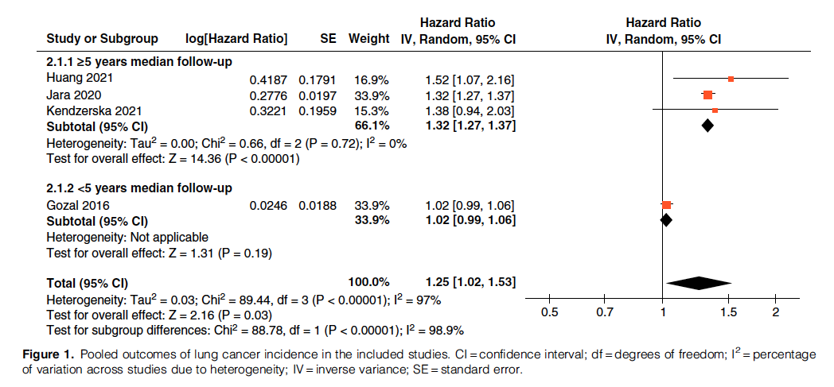
META-analysis of OSA-Lung Cancer risk https://www.atsjournals.org/doi/abs/10.1513/AnnalsATS.202108-960OC
7 studies; 4 included in meta-analysis.
Low quality of evidence (due to heterogeneity and low number of studies) – problems of inadequate adjustment (no smoking adjustment in sum studies)
4.8 million patients included; HR 1.25

Slide 11
https://erj.ersjournals.com/content/53/2/1800893.short
Mechanisms review
Contains overview of mechanisms, as well as summary of trial data that evaluates changes in hypercoagulability after starting CPAP

Slide 12
OSA and VTE - https://doi.org/10.1016/j.smrv.2019.101233
Obesity, sedentary behavior, and Age are major risk factors for both OSA and are major risk factors for VTE *
Mechanistic theory: increased oxidative stress and endothelial activation; evidence by fibrinogen, ddimer, platelet activity, and HCT are found in patients with OSA.
Systematic review of 18 studies OSA-VTE suggested a 2-4x increase risk of venous thromboembolism, through a variety of methods (peri-operative, prospective cohorts in enriched populations, and population based methods). However, adequate confounder adjustments remains problematic, and improvement of the risk with treatment have not been shown and thus should be viewed as tentative.
Notes:
Obesity - VTE
*S.V. Konstantinides, A. Torbicki, G. Agnelli, N. Danchin, D. Fitzmaurice, N. Galiè, et al.2014 ESC guidelines on the diagnosis and management of acute pulmonary embolism
Eur Heart J, 35 (2014), pp. 3033-3069, 10.1093/eurheartj/ehu283
W. Ageno, C. Becattini, T. Brighton, R. Selby, P.W. KamphuisenCardiovascular risk factors and venous thromboembolism: a meta-analysis
Circulation, 117 (2008), pp. 93-
37 oxidative:
A. Alonso-Fernandez, F. Garcia-Rio, M.A. Arias, A. Hernanz, M. de la Pena, J. Pierola, et al.Effects of CPAP on oxidative stress and nitrate efficiency in sleep apnoea: a randomised trial
Thorax, 64 (2009), pp. 581-586,
38 endothelial:
M.A. Arias, F. Garcia-Rio, A. Alonso-Fernandez, A. Hernanz, R. Hidalgo, V. Martinez-Mateo, et al.CPAP decreases plasma levels of soluble tumour necrosis factor-alpha receptor 1 in obstructive sleep apnoea
Eur Respir J, 32 (2008), pp. 1009-1015
“It should be noted that there are no studies on whether OSA treatment (with CPAP, oral appliance, and/or weight reduction) reduces the risk of incident or recurrent VTE.”

Slide 13
https://doi.org/10.1016/j.chest.2021.12.630
Single largest center – Pitt review of 30k patients
OSA associated with VTE, but relationship disappeared once BMI added to multivariable model.

